Slide 1
JCM
OSCE
AHNH
7th January 2015

Slide 2
Case 1

Slide 3
M/23
CC
  Fever/sore throat/jaundice 1 week
  Attended A&E 1 week ago
  No travel history
  Good past health

Slide 4
PE
  Jaundice
  Bilateral cervical LNs
  Exudative tonsillitis
  No stigmata of CLD
  Abdomen and chest NAD

Slide 5
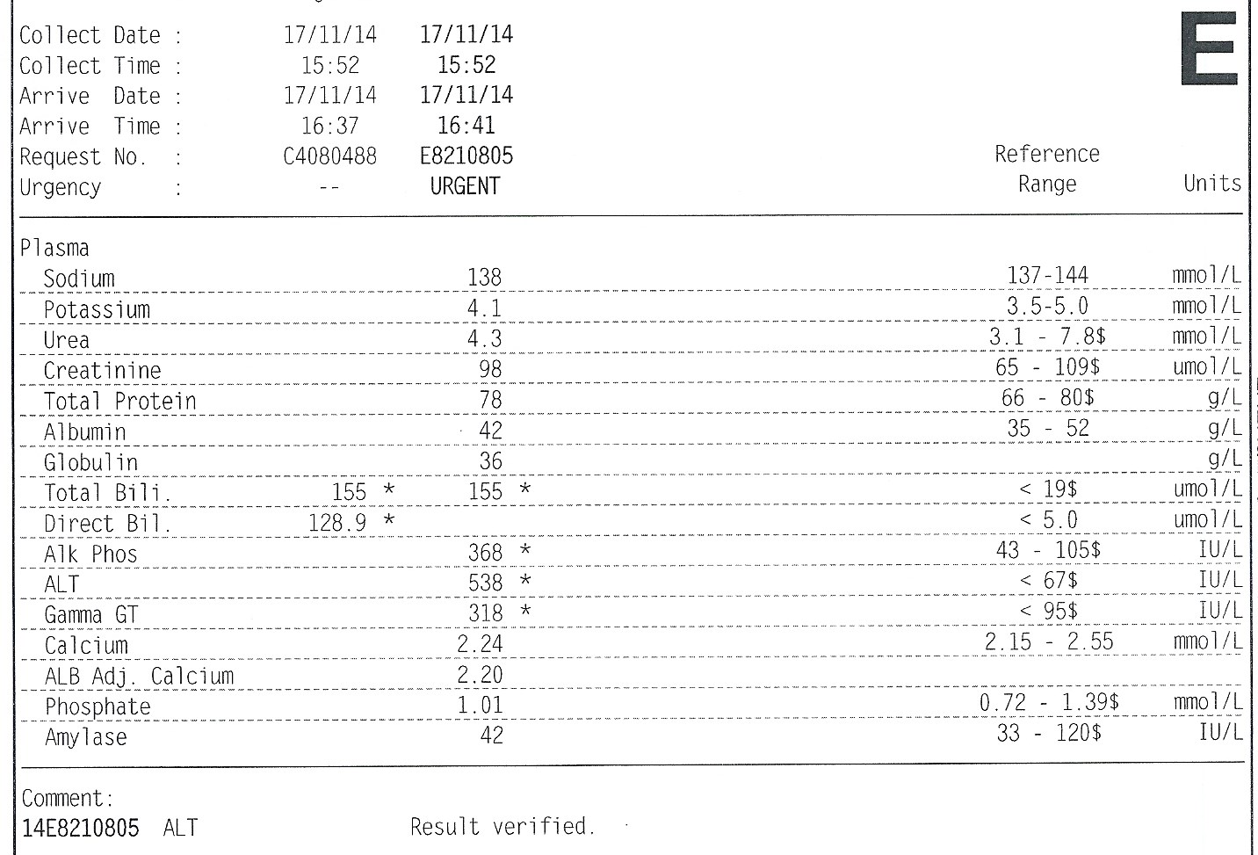

Slide 6
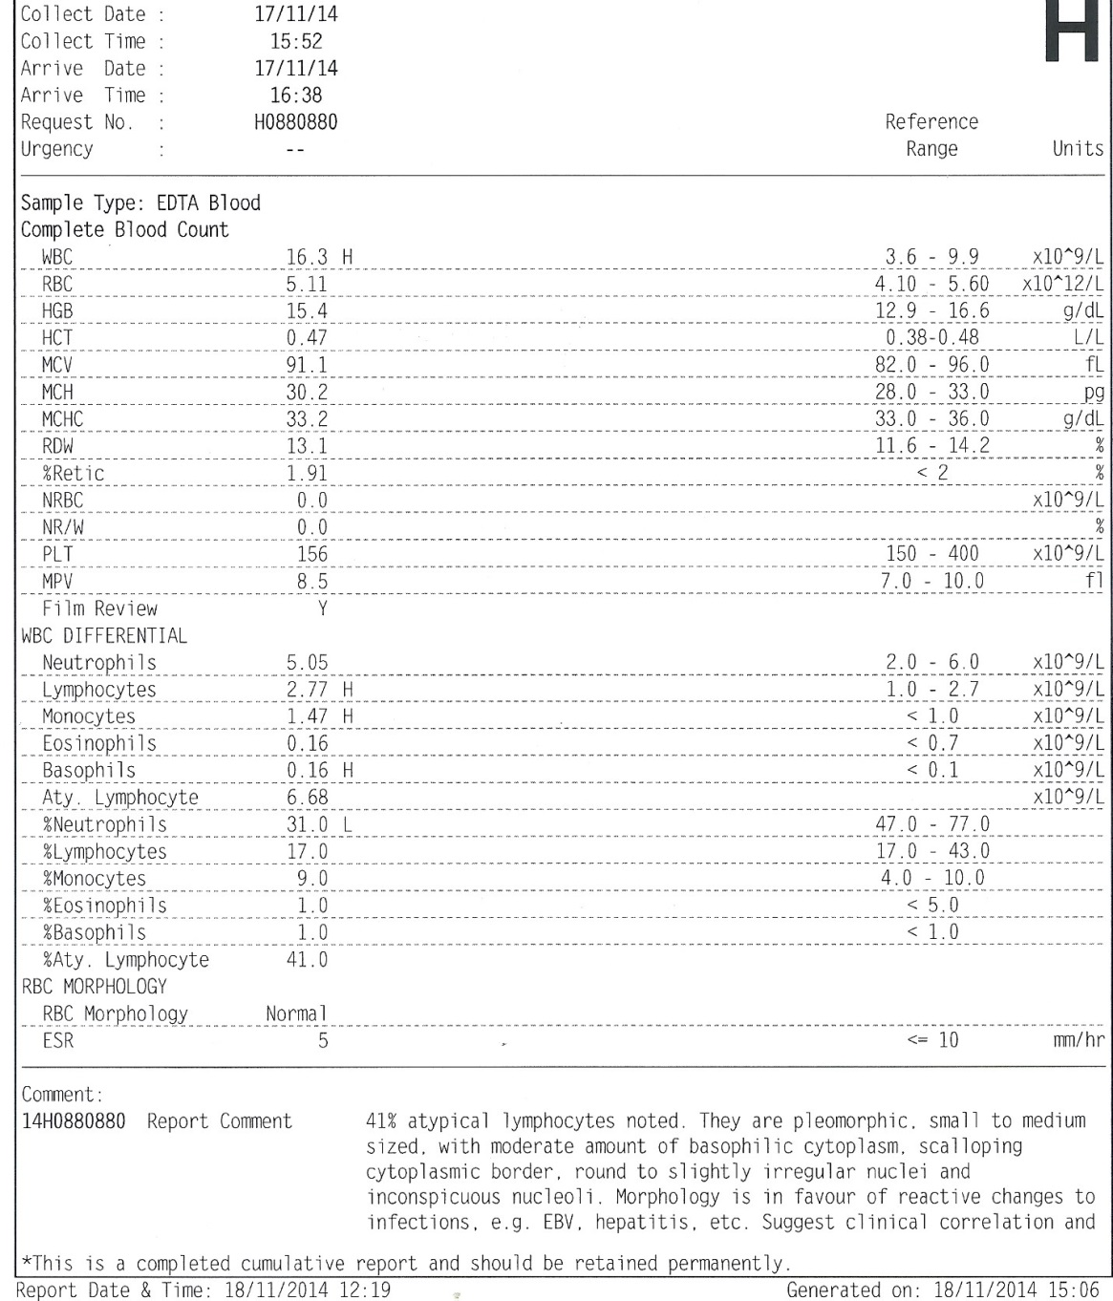

Slide 7
Give one diagnosis to account for the clinical findings.
Suggest 3 other differential diagnoses.
Name the blood test to confirm the diagnosis.
Give 3 complications of the condition.
What is the treatment for the condition?

Slide 8
Case 2

Slide 9
M/78
DM/HT
Admitted med for chest pain 5 days ago
Started on Aspirin
Pending private CTA
Sudden collapse in street 2 days after discharge
BP 130/68 P 120 SpO2 74%
GCS E4V1M5
CXR unremarkable

Slide 10
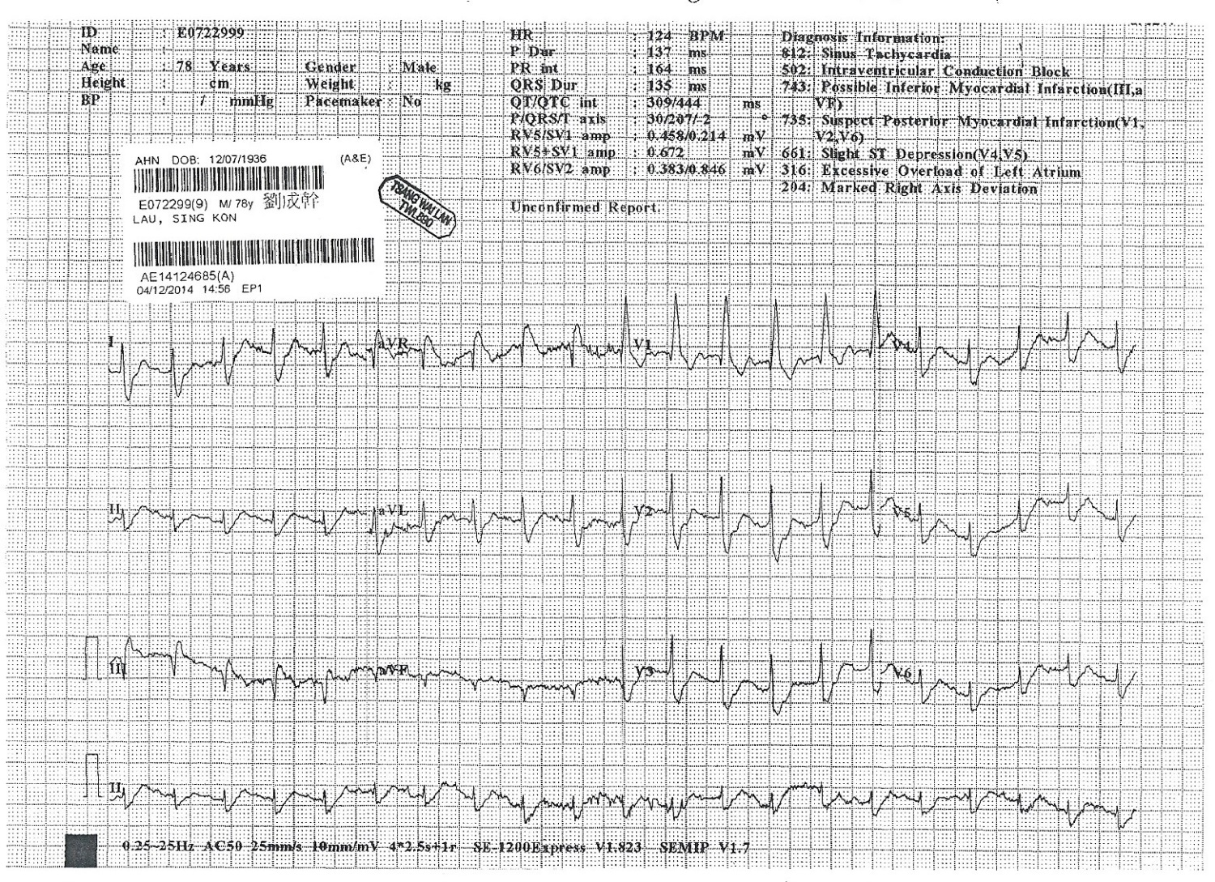

Slide 11
Give 3 descriptions of the ECG.

Slide 12
The patient is stabilized with endotracheal intubation and mechanical ventilation at A&E.

Slide 13
What is the investigation of choice?
What are the treatment options?

Slide 14
Case 3

Slide 15
M/63
NPC with RT 6 years ago
CC
  Dizziness and vomiting for 3 days
PE
  15/15
  Dehydrated
  Respiratory/CVS/CNS/Abdomen NAD

Slide 16
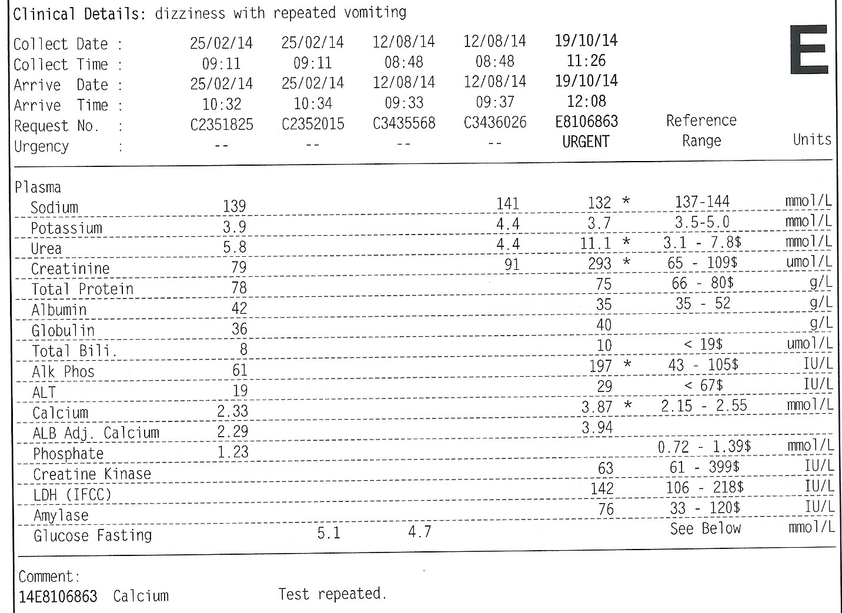

Slide 17
What is the clinical diagnosis?
Suggest 3 causes which can give rise to the condition.
What are the treatment for the condition?

Slide 18
Case 4

Slide 19
M/62
HT/pAF/IHD
On aspirin etc
Sudden dense right side weakness for 1 hour
BP 167/88 P80
GCS E4V1M5

Slide 20
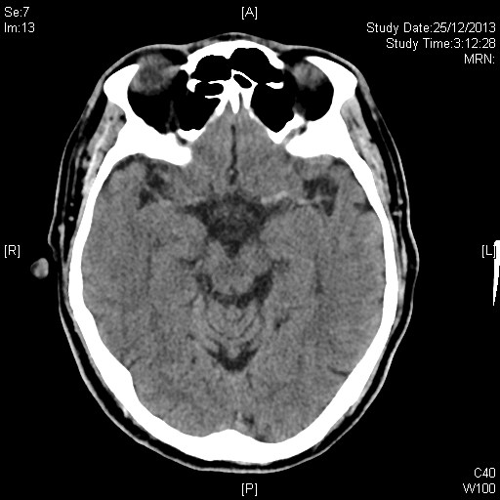

Slide 21
Name the radiological sign present.
Give 3 other CT signs which may be present for the condition.
Give 2 CNS complications of the condition.

Slide 22
Case 5

Slide 23
M/23
Fell while playing football
Left wrist pain and swelling

Slide 24
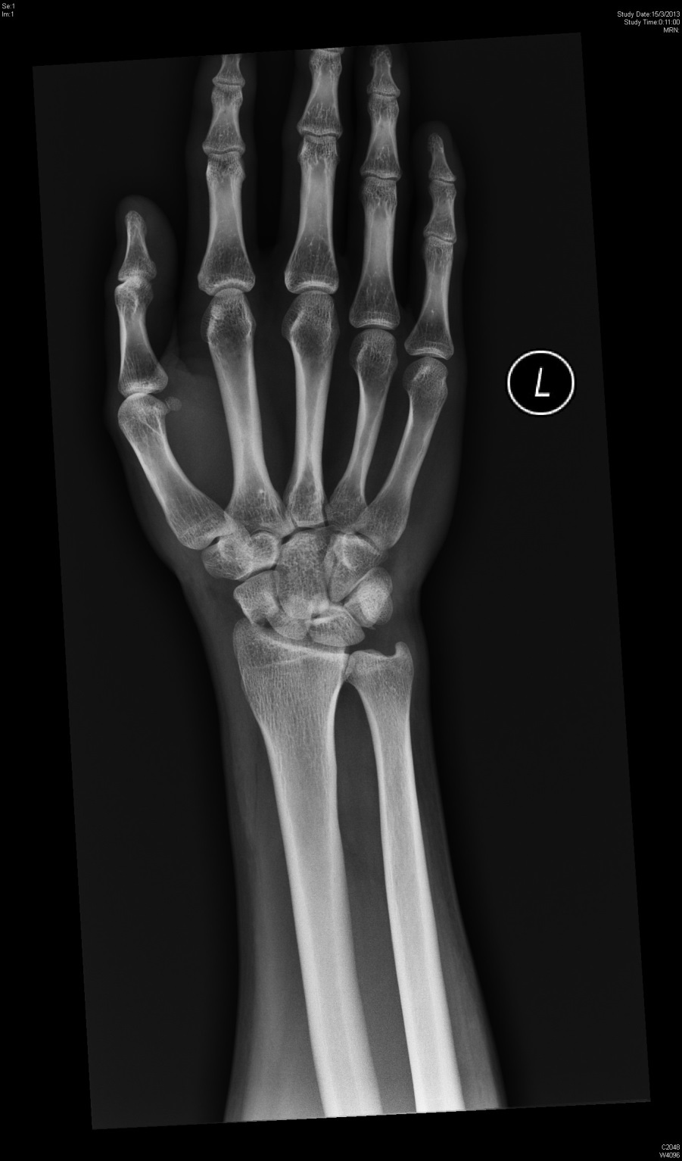

Slide 25
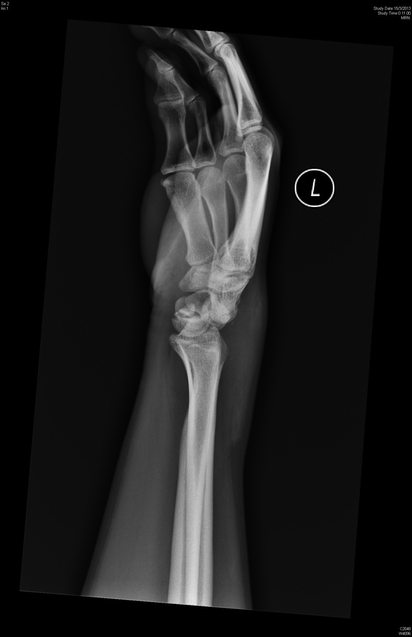

Slide 26
What is the diagnosis?
What is the management?
Give 4 complications.

Slide 27
Case 6

Slide 28
M/45
Rt ear discharge for 2 weeks
Rt side headache/neck pain/diplopia 2 days

Slide 29
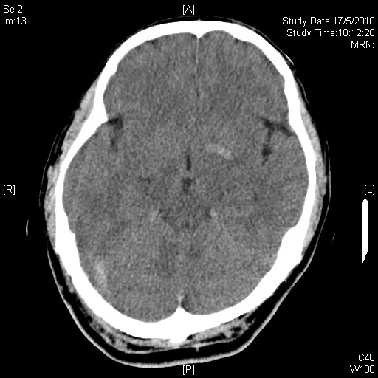

Slide 30
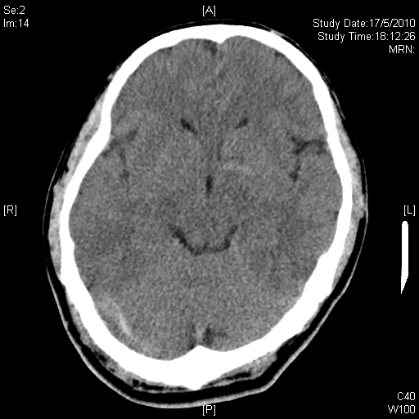

Slide 31
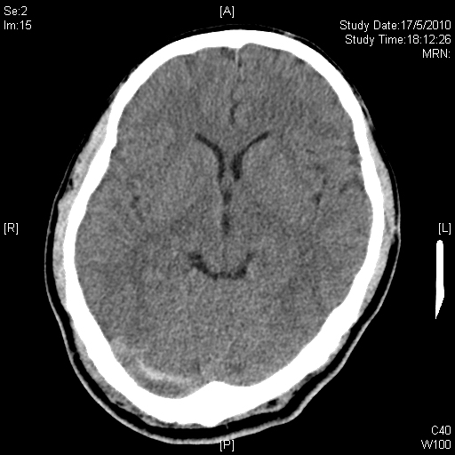

Slide 32
What is the clinical diagnosis?
What is the investigation of choice to confirm the diagnosis?
What should be the management?

Slide 33
The end

